Slide 1
STUDENT NAME: SOWBIYA. S
NM ID : FF44686EB1F56C0AE4B40A5F0EEA016B
REGISTER NO: 122200745
DEPARTMENT: B.COM (CS)
COLLEGE : ASAN MEMORIAL COLLEGE OF ART&SCIENCE
1

Slide 2
Employee Performance Analysis using Excel

Slide 3




Problem Statement
Project Overview
End Users
Our Solution and Proposition
Dataset Description 6.Modelling Approach 7.Results and Discussion
8.Conclusion

Slide 4
e organization is facing challenges in accurately evaluating and improving employee performance due to a lack of structured data analysis methods. Current evaluation processes are largely manual, leading to inconsistencies, delays, and potential biases in performance assessments. Additionally, the company lacks a comprehensive view of employee performance trends over time, which hinders informed decision-making for promotions, training, and other HR interventions.To address these issues, the project aims to develop an Excel-based solution that will systematically analyze employee performance data. is solution will include data aggregation, statistical analysis, and visualization tools to identify key performance indicators (KPIs), trends, and outliers. e goal is to provide the HR department with actionable insights that are data-driven, consistent, and easily interpretable.By the end of the project, the organization should have a robust Excel model that enables accurate, timely, and unbiased employee performance evaluations, contributing to better workforce management and overall organizational productivity.

Slide 5



e primary objective of this project is to develop an Excel-based tool that can e£fe•c.tively analyze and evaluate employee performance data. is tool will
enable HR managers and team leaders to gain actionable insights into
employee performance, identify trends, and make informed decisions regarding promotions, training, and resource allocation.Scope: is project involves collecting, organizing, and analyzing employee performance data, including metrics such as productivity, quality of work, attendance, and peer/ managerial reviews. e analysis will be conducted using Excel's advanced functionalities, such as pivot tables, statistical functions, and data visualization tools. e project will also involve creating dashboards and reports that summarize key performance indicators (KPIs) and provide a clear picture of individual and team performance over time.
5

Slide 6

Managers: Assess and track employee and team performance for decision-making on promotions and development.HR Professionals: Use data for performance reviews, training needs, and strategic planning.Team Leaders: Monitor team performance, provide feedback, and identify areas for improvement.Executives: Review aggregated data for organizational insights and strategic decisions.
6

Slide 7
our
Training and Development: Create targeted training programs to address skill gaps.Incentives: Design performance-based incentives to motivate employees.Process Improvement: Optimize workflows and improve communication to enhance productivity.Feedback and Coaching: Implement regular feedback and coaching sessions.
7

Slide 8

Employee ID: Unique identiﬁer for each employee.Name: Employee's full name (often anonymized in datasets).Department: e department or team the employee belongs to.Job Title: e role or position held by the employee.Date of Hire: e date the employee started working with the organization.Years of Experience: Total years of experience the employee has, both within and outside the organization.

Slide 9



Real-Time Performance Tracking:Enables immediate monitoring and adjustments to employee performance, promoting agility and continuous improvement.Advanced Analytics and AI:Uses data analytics and AI to identify trends, predict outcomes, and recommend personalized actions, aiding in data-driven decision-making.
3/21/2024
Annual Revźew
9

Slide 10
Employee data-Kaggle
‣ I take this data in the Naan Mudhalvan website and click the edunet dashbord . ere we should update our Proﬁle. en click on the employee data set( Kaggle). It downloads in the PC.
Sort the Data:
Open the data through Excel, then select all the data in the sheet, then click the 'row and column' in the ribbon tab and choose the autoﬁt row and column width option. Using the conditional format we ﬁll the blank column by di£ferent colours. Select any features and highlight in our favorite colour.

Slide 11
Modelling
PIVOT TABLE
Copy the selected features and paste it in new sheet. Select the all features and create the Pivot table. Order the features in this following as ROW: Employee status, Playzone COLOUMN: Employee type VALUES: Current employee rating FILTER: Gender en the table will be created
.
PIVOT CHART
Select the table and click the Pivot Chart option and choose our favorite chart example: Bar chart, Pie chart etc... en we ﬁnish the chart
11

Slide 12
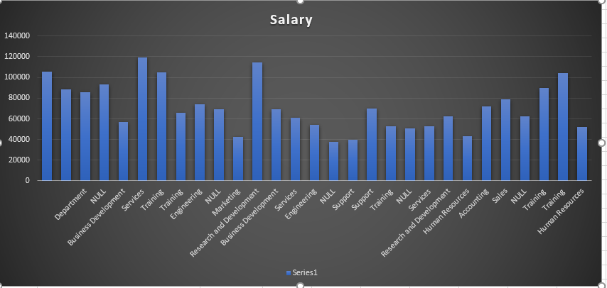
1
2

Slide 13

Performance Drivers: Training, experience, and feedback are crucial for high performance.Employee Segmentation: Identiﬁes performance clusters, guiding targeted interventions and recognition.Predictive Insights: Helps anticipate and address potential performance issues proactively.Recommendations: Focus on targeted training, recognition programs, and e£fective resource allocation.Bias and Fairness: Ensure evaluations are unbiased and equitable.

Slide 14

Zoho Show
Employee_Data_Analysźs_2.pdf
(Thźs PDF has been generated usźng Zoho Show)
To create beautźful presentatźons, download Zoho Show from Play Store https://zoho.to/cy7

